Slide 1

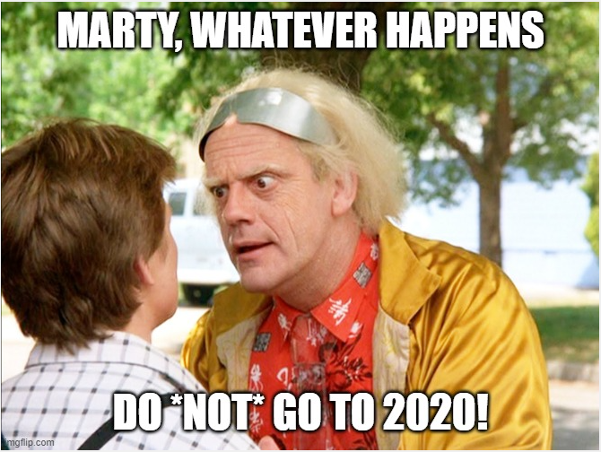

Burnout
more than just a bad day!
Seth Petry-Johnson

Slide 2
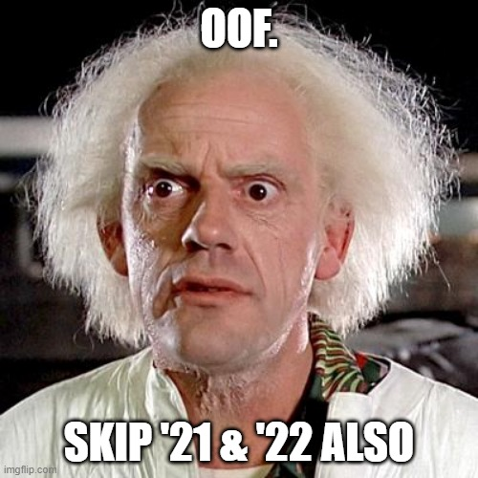
Burnout
more than just a bad day!
Seth Petry-Johnson

Slide 3
Burnout
more than just a bad day!
Seth Petry-Johnson

Slide 4

Burnout
more than just a bad day!
Seth Petry-Johnson
Employed Americans reporting worker burnout
76%

Slide 5
Burnout
more than just a bad day!
Seth Petry-Johnson
Employed Americans reporting complete burnout
9%

Slide 6
Burnout
more than just a bad day!
Seth Petry-Johnson
Employed Americans w/ no ideas for reducing burnout
1 in 10
Today’s agenda
Understanding burnout
Diagnosing and evaluating burnout
Treating / managing burnout

Slide 7
Burnout
more than just a bad day!
Seth Petry-Johnson
Employed Americans w/ no ideas for reducing burnout
1 in 10
Today’s agenda
Understanding burnout
Diagnosing and evaluating burnout
Treating / managing burnout

Slide 8
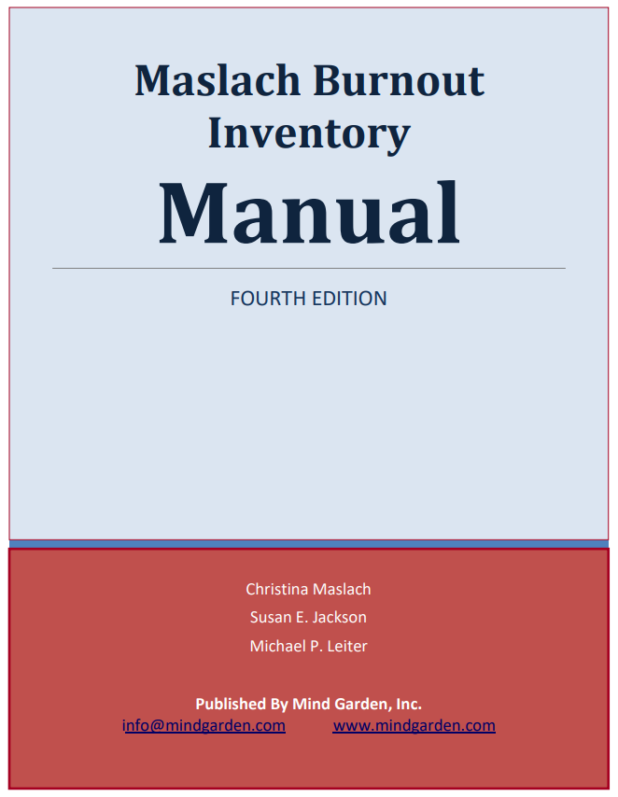
Burnout
more than just a bad day!
Seth Petry-Johnson
Understanding burnout

Slide 9
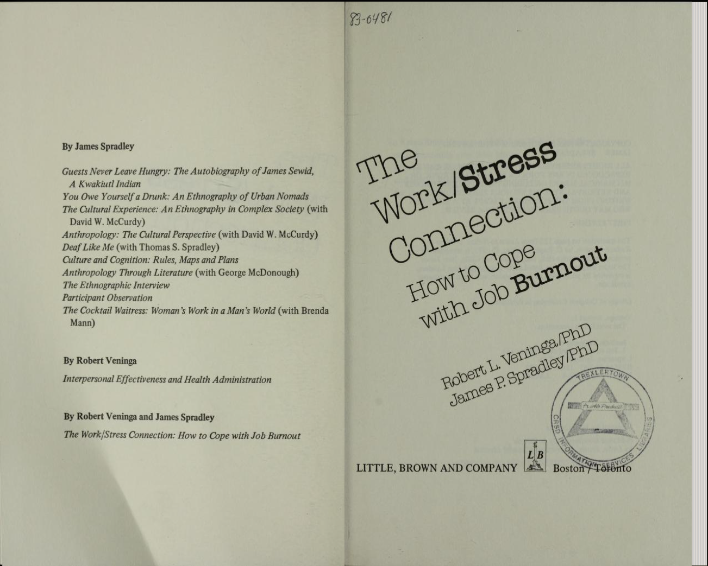
Burnout
more than just a bad day!
Seth Petry-Johnson
Understanding burnout

Slide 10
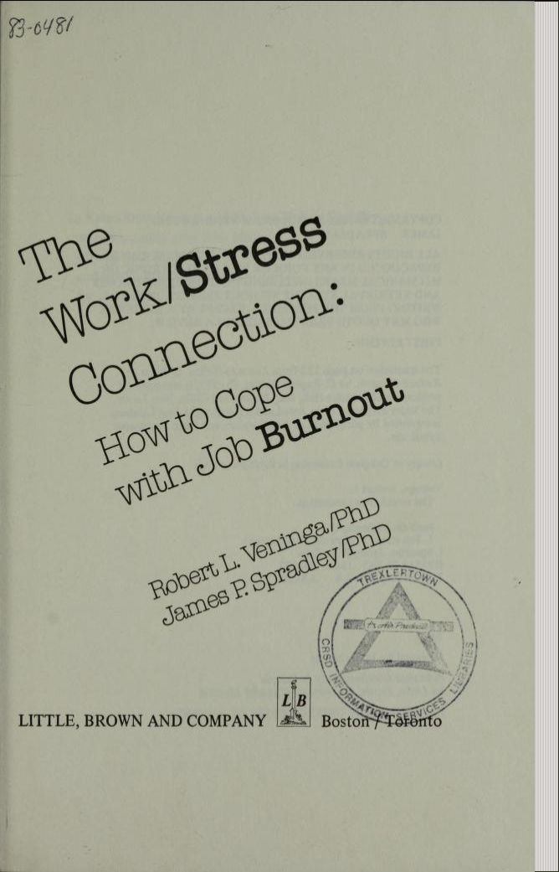
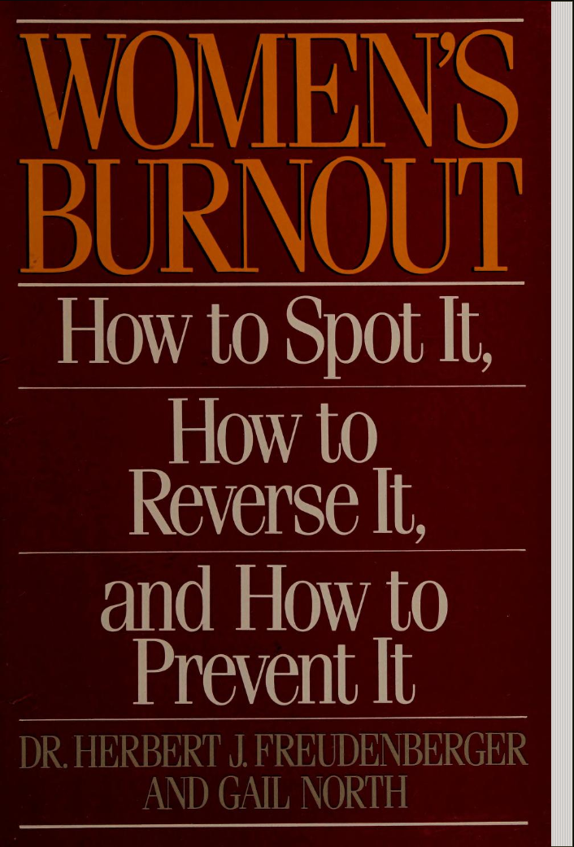
Burnout
more than just a bad day!
Seth Petry-Johnson
Understanding burnout

Slide 11
Burnout
more than just a bad day!
Seth Petry-Johnson
Understanding burnout

Slide 12
Burnout
more than just a bad day!
Seth Petry-Johnson
Understanding burnout
Burnout is a syndrome,
not a specific diagnosis

Slide 13
Burnout
more than just a bad day!
Seth Petry-Johnson
Understanding burnout
Burnout is a syndrome,
not a specific diagnosis
A syndrome is a group of symptoms that consistently occur together
Veninga and Spradley 5 stages
Burnout symptoms accompany chronic unmanaged stress
in the workplace

Slide 14


Burnout
more than just a bad day!
Seth Petry-Johnson
Veninga and Spradley 5 stages of workplace burnout
Honeymoon
High job satisfaction
Commitment / energy / creativity
Stress feels like “good stress”; we don’t recognize adaptation energy being used up

Slide 15

Burnout
more than just a bad day!
Seth Petry-Johnson
Veninga and Spradley 5 stages of workplace burnout
Fuel Shortage
Honeymoon
Begin to overdraw adaptation energy
Vague feeling of loss
“Balancing act”

Slide 16

Burnout
more than just a bad day!
Seth Petry-Johnson
Veninga and Spradley 5 stages of workplace burnout
Fuel Shortage
Chronic Symptoms
Honeymoon
Chronic exhaustion
Physical illness
Anger / depression

Slide 17

Burnout
more than just a bad day!
Seth Petry-Johnson
Veninga and Spradley 5 stages of workplace burnout
Fuel Shortage
Chronic Symptoms
Honeymoon
Crisis
Chronic exhaustion
Physical illness
Anger / depression

Slide 18
Burnout
more than just a bad day!
Seth Petry-Johnson
Veninga and Spradley 5 stages of workplace burnout
Fuel Shortage
Chronic Symptoms
Hitting the Wall
Honeymoon
Crisis
Chronic exhaustion
Physical illness
Anger / depression

Slide 19
Burnout
more than just a bad day!
Seth Petry-Johnson
Veninga and Spradley 5 stages of workplace burnout
Honeymoon

Slide 20
Burnout
more than just a bad day!
Seth Petry-Johnson
Veninga and Spradley 5 stages of workplace burnout
Honeymoon

Slide 21
Burnout
more than just a bad day!
Seth Petry-Johnson
Veninga and Spradley 5 stages of workplace burnout
Honeymoon

Slide 22
Burnout
more than just a bad day!
Seth Petry-Johnson
Veninga and Spradley 5 stages of workplace burnout
Honeymoon

Slide 23
Burnout
more than just a bad day!
Seth Petry-Johnson
Veninga and Spradley 5 stages of workplace burnout

Slide 24
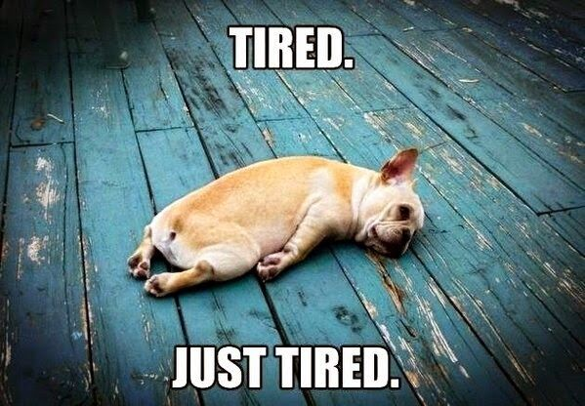
Burnout
more than just a bad day!
Seth Petry-Johnson
Understanding burnout
Burnout symptoms:
Depleted energy reserves
Pervasive feeling of exhaustion

Slide 25
Burnout
more than just a bad day!
Seth Petry-Johnson
Understanding burnout
Burnout symptoms:
Depleted energy reserves
Hard to get out of bed in the morning

Slide 26
Burnout
more than just a bad day!
Seth Petry-Johnson
Understanding burnout
Burnout symptoms:
Depleted energy reserves
Loss of interest in leisure activities

Slide 27
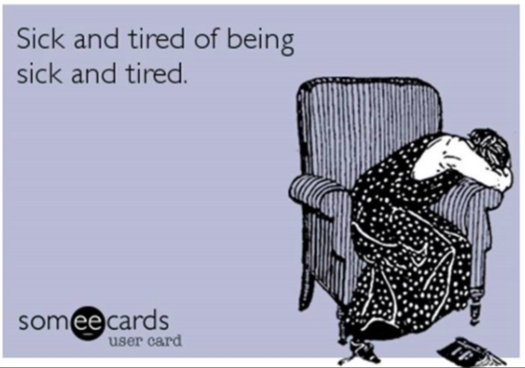
Burnout
more than just a bad day!
Seth Petry-Johnson
Understanding burnout
Burnout symptoms:
Depleted energy reserves
Withdrawal from relationships /
“No fun to be around”

Slide 28
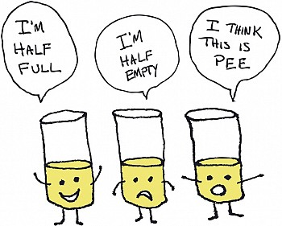
Burnout
more than just a bad day!
Seth Petry-Johnson
Understanding burnout
Burnout symptoms:
Depleted energy reserves
Lowered resistance to illness

Slide 29
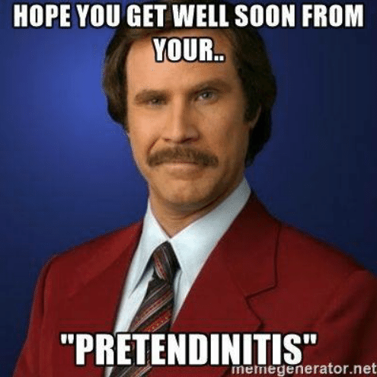
Burnout
more than just a bad day!
Seth Petry-Johnson
Understanding burnout
Burnout symptoms:
Depleted energy reserves
Lowered resistance to illness
Increased dissatisfaction and pessimism

Slide 30
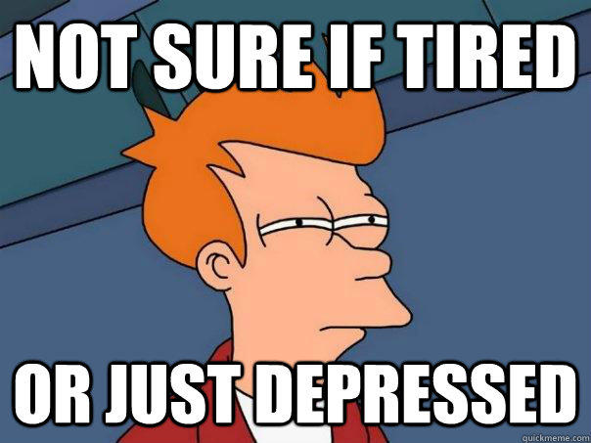
Burnout
more than just a bad day!
Seth Petry-Johnson
Understanding burnout
Burnout symptoms:
Depleted energy reserves
Lowered resistance to illness
Increased dissatisfaction and pessimism
Increased absenteeism and inefficiency at work

Slide 31
Burnout
more than just a bad day!
Seth Petry-Johnson
Understanding burnout
Burnout symptoms:
Depleted energy reserves
Lowered resistance to illness
Increased dissatisfaction and pessimism
Increased absenteeism and inefficiency at work

Slide 32
Burnout
more than just a bad day!
Seth Petry-Johnson
Understanding burnout
Burnout is a syndrome of three types of feelings:
Emotional exhaustion
Depersonalization
Low personal accomplishment

Slide 33

Burnout
more than just a bad day!
Burnout is a state of
emotional, physical, and mental exhaustion
caused by excessive and prolonged stress
Today’s agenda
Understanding burnout
Diagnosing and evaluating burnout
Treating / managing burnout

Slide 34
Burnout
more than just a bad day!
Burnout is a state of
emotional, physical, and mental exhaustion
caused by excessive and prolonged stress
Pandemic
Inflation
Politics
Job insecurity
Family stress
WFH / RTO
Adulting
Turnover

